Slide 1
Christmas MERN Project
Your presents is requested at this presentation.

Slide 2
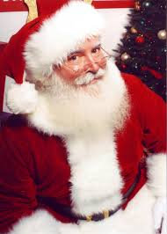
You snow the drill. We’re going to talk about the why.
Our client: The big guy in the North Pole – Santa.
Why does he need a website? Well, obviously he has great word of mouth, but Santa is trying to reduce his impact on the environment. He also wants to make things a bit easier for his elves.
How can we help? By creating a site where kids can fill in a letter to Santa online instead of sending one via post. People can also create gift lists for their friends and family members, this way the elves can collate this data to check on current gift trends and to ensure they’re making the right types of presents. We’ll also be creating a section for secret Santa groups for even more data.

Slide 3
But wait—there’s myrrh.
Target Audience: Parents, children, secret Santa participants.
Tech Stack:
Front-end: HTML, CSS, JavaScript, React.
Back-end: Express, NodeJs.
Database: MongoDB, Mongoose.
Deployment: Heroku, Netlify.
Project Management Tools: Trello, Discord.
Testing: Cypress, Mocha.
DevOps Tools: git, GitHub, Visual Studio Code.
Design Tools: Figma, diagrams.net, Xtensio.

Slide 4
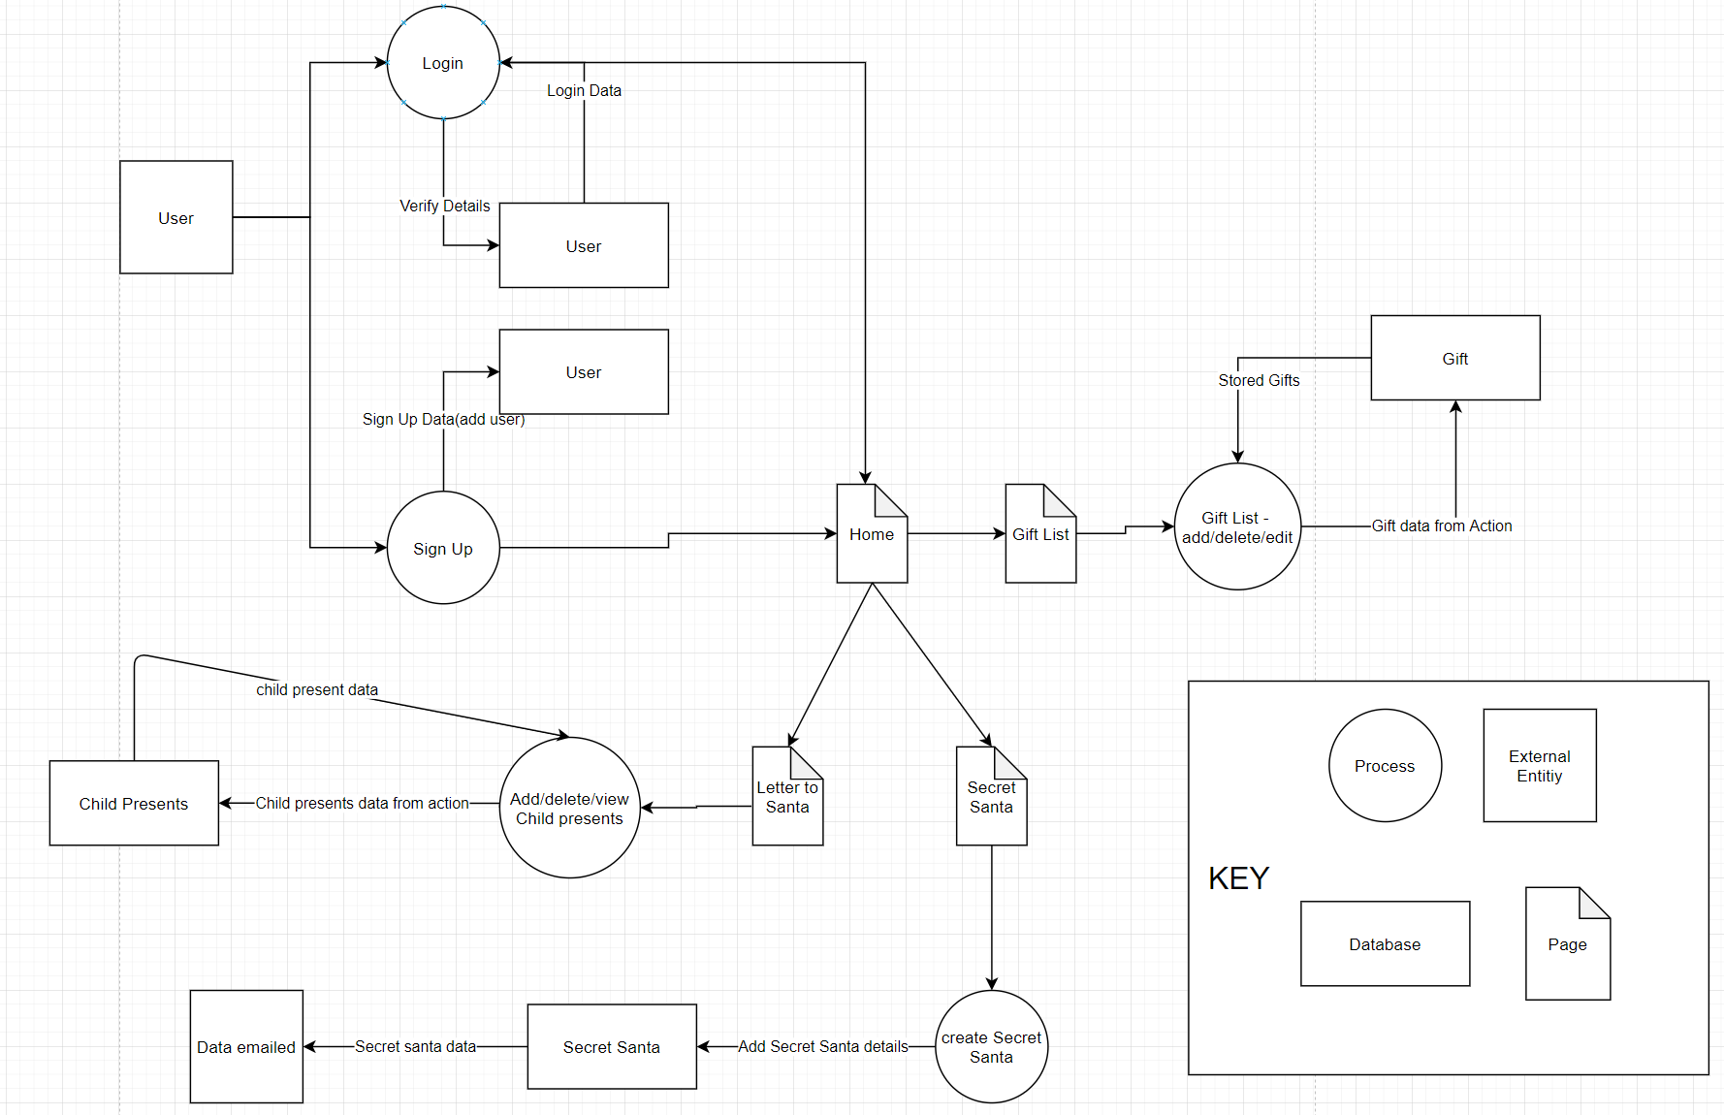
Oh, deer. It’s the Dataflow Diagram.

Slide 5
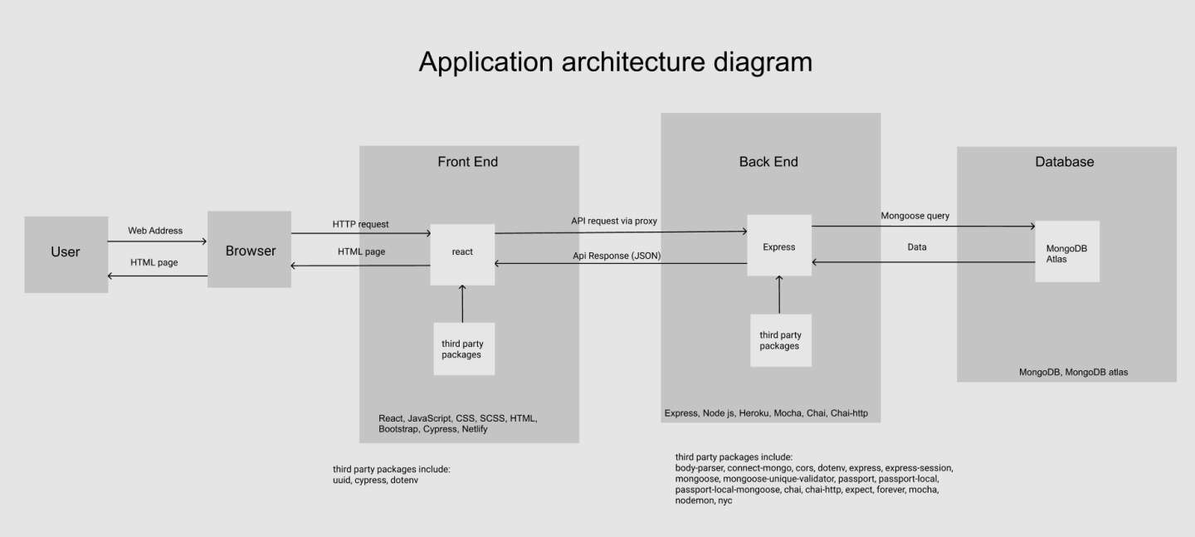
Sleigh, what?! The Application Architecture Diagram, too?!

Slide 6
How rude-olph of you. Let’s think about the client - user stories.
3 different iterations.
First iteration - We considered what our users would want in terms of functionality and wrote cases for it like:
As a child I want to be able to create a list of gifts I want from Santa.
Second iteration – We created user personas to better understand our clients needs and wants. More on that in the next slide.
Third iteration – We delved further into the why of our user stories. Instead of considering just what our users wanted we tried to isolate the motivations. This was helped greatly by our user personas. Updated like so:
As a child I want to be able to create a list of gifts I want from Santa so I can ensure he knows what I want.

Slide 7
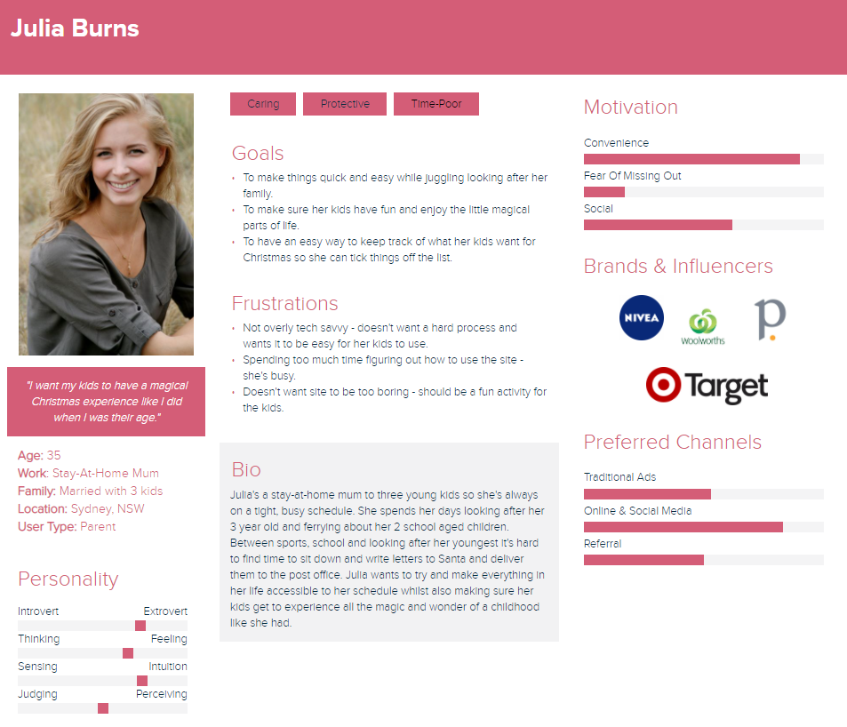
Snow, don’t tell - User Persona Example

Slide 8
That look soots you – wireframes and design.
Wireframes were created using Figma. We opted for detailed wireframes so the coding process would be straightforward for the front-end.
Typography was considered: headings in Berkshire Swash to ensure they were eye-catching and blocks of text in the sans serif font Karla for readability.
Colour palette: we wanted to stick with Christmas colours so went with red for backgrounds and white for text. Both colours were customised with the background having added greens and blues to use colour #B60D0F and the font colour having subtle hints if red in colour #FBF3F3.

Slide 9
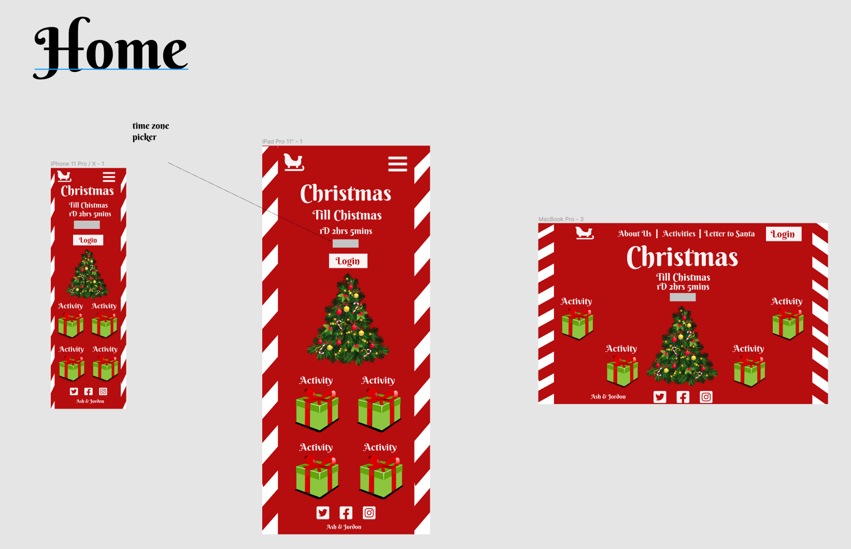
It’s beginning to look a lot like a wireframe example.

Slide 10
Trello-lo-lo-lo-lo-lo-lo-lo and Planning Methodology.
Failing to plan is just planning to fail, am I right?
We created a Trello board very early on. It includes all marking criteria, features broken down into MVP and sprinkles, research, user stories and then moves into a Kanban style with to do, backlog, doing, testing and completed.
For our planning methodology we considered both Kanban and scrum, however, the flexibility of Kanban was too much of a draw and we opted to go with the Kanban approach.

Slide 11
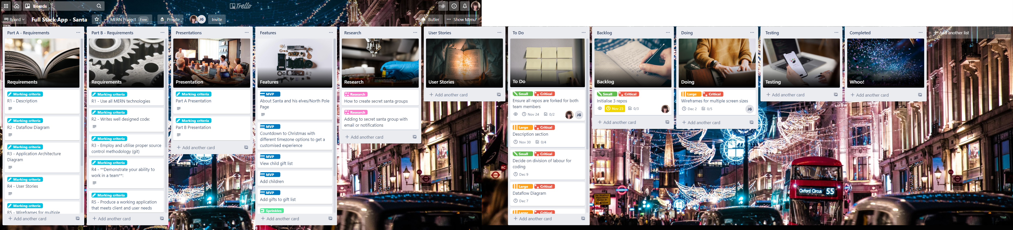
Let’s take an elfie – one of our Trello screenshots.

Slide 12
A round of Santa-plause, please.
Any questions?

